Slide 1

Fundamentals of Economics
M.M.L.C.Gunathilake
Senior Lecturer gr ii
Department of Management and Finance
General Sir John Kotelawala Defence University
Ratmalana

Slide 2

Lesson 03
Concept of Elasticity

Slide 3
Elasticity of Demand
We have seen that
  The quantity demanded of a consumer good is affected by
    its price
    prices of other goods
    buyers’ incomes, etc.
  The quantity supplied of a good is affected by
    its price
    prices of raw materials, etc.
Elasticity seeks to measure the strengths of these various effects

Slide 4
Price Elasticity of Demand
Price elasticity of demand is a measure of how much the quantity demanded of a good responds to a change in the price of that good.
Examples:
  The price elasticity of demand is the percent increase in the quantity demanded of a product when there is a one percent increase in the price of the product

Slide 5
Price Elasticity of Demand
Arc Price elasticity:
Point Price elasticity:
The coefficient on Price of demand function.
Ex) Q=22-2P:

Slide 6
More about Price Elasticity
Demand highly elastic when price elasticity of demand has large absolute value
Why one good is more elastic?
  Availability of substitutes

Slide 7
The Elasticity of Demand
Price elasticity of demand is a measure of how much the quantity demanded of a good responds to a change in the price of that good.
It is the percentage increase in quantity demanded when there is a one percent increase in the price
  and all other factors that also affect the quantity demanded remain unchanged

Slide 8
More about Price Elasticity
Elasticity | Demand is considered… |  | If P increases, then total expenditure...
e = 0 | perfectly inelastic | Qd completely insensitive to Δ in P | increases
0 < e < 1 | Relatively inelastic | Qd highly insensitive to Δ in P | increases
e = 1 | unit elastic | % Δ in Qd exactly the same as the % Δ in P | does not change
1 < e < ∞ | Relatively elastic | Qd highly sensitive to Δ in P | decreases
e = ∞ | perfectly elastic | Qd extremely sensitive to Δ in P | decreases

Slide 9

Figure 1 The Price Elasticity of Demand
(a) Perfectly Inelastic Demand: Elasticity Equals 0
Price
Demand
$5
4
1. An
increase
in price . . .
0
100
Quantity
2. . . . leaves the quantity demanded unchanged.
Copyright©2003 Southwestern/Thomson Learning

Slide 10
Figure 1 The Price Elasticity of Demand
(b) Inelastic Demand: Elasticity Is Less Than 1
Price
$5
4
1. A 22%
Demand
increase
in price . . .
0
90
100
Quantity
2. . . . leads to an 11% decrease in quantity demanded.

Slide 11
Figure 1 The Price Elasticity of Demand
(c) Unit Elastic Demand: Elasticity Equals 1
Price
$5
4
1. A 22%
Demand
increase
in price . . .
0
80
100
Quantity
2. . . . leads to a 22% decrease in quantity demanded.

Slide 12
Figure 1 The Price Elasticity of Demand
(d) Elastic Demand: Elasticity Is Greater Than 1
Price
$5
4
Demand
1. A 22%
increase
in price . . .
0
50
100
Quantity
2. . . . leads to a 67% decrease in quantity demanded.

Slide 13
Figure 1 The Price Elasticity of Demand
(e) Perfectly Elastic Demand: Elasticity Equals Infinity
Price
1. At any price
above $4, quantity
demanded is zero.
$4
Demand
2. At exactly $4,
consumers will
buy any quantity.
0
Quantity
3. At a price below $4,
quantity demanded is infinite.

Slide 14
Total Revenue and the Price Elasticity of Demand
Total revenue is the amount paid by buyers and received by sellers of a good.
Computed as the price of the good times the quantity sold.
TR = P x Q

Slide 15
Figure 2 Total Revenue
Price
$4
P × Q = $400
P
(revenue)
Demand
0
100
Quantity
Q
Copyright©2003 Southwestern/Thomson Learning

Slide 16
Elasticity and Total Revenue along a Linear Demand Curve
With an inelastic demand curve, an increase in price leads to a decrease in quantity that is proportionately smaller. Thus, total revenue increases.

Slide 17
Figure 3 How Total Revenue Changes When Price Changes: Inelastic Demand
Price
Price
An Increase in price from $1
to $3 …
… leads to an Increase in total revenue from $100 to $240
$3
Revenue = $240
$1
Revenue = $100
Demand
Demand
0
100
Quantity
0
80
Quantity

Slide 18
Elasticity and Total Revenue along a Linear Demand Curve
With an elastic demand curve, an increase in the price leads to a decrease in quantity demanded that is proportionately larger. Thus, total revenue decreases.

Slide 19
Figure 4 How Total Revenue Changes When Price Changes: Elastic Demand
Price
Price
An Increase in price from $4
to $5 …
… leads to an decrease in total revenue from $200 to $100
$5
$4
Demand
Demand
Revenue = $200
Revenue = $100
0
50
Quantity
0
20
Quantity

Slide 20
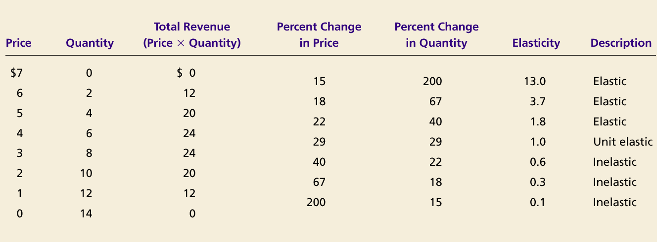
Elasticity of a Linear Demand Curve

Slide 21
The Price Elasticity of Demand and Its Determinants
Availability of Close Substitutes
Necessities versus Luxuries
Definition of the Market
The proportion of consumer’s income spent
Demand tends to be more elastic :
  the larger the number of close substitutes.
  if the good is a luxury.
  the more narrowly defined the market.
  the longer the time period.
  The greater portion of income spend on the product

Slide 22
Importance of price elasticity of Demand
Price decisions by firms
Use in Economic policy regarding price regulation especially of farm products
Importance in fiscal policy

Slide 23
Income Elasticity
Income elasticity
=
The coefficient on INCOME of demand function.
Ex) Q=1200-16*P+0.2*I :
Elasticity | Goods are considered…
e_{Y} < 0 | Inferior good
0 ≤ e_{Y} ≤1 | Normal, Necessity
e_{Y} > 1 | Normal, Luxury

Slide 24
Income Elasticity of Demand
Income elasticity of demand is the percentage increase in the quantity demanded of a good after a one-percent increase in buyers’ income
  assuming all other factors that affect the quantity demanded are unchanged

Slide 25
Income Elasticity
Normal Goods: IED > 0
Inferior Goods: IED < 0
Higher income raises the quantity demanded for normal goods but lowers the quantity demanded for inferior goods.
Examples

Slide 26
Goods consumers regard as necessities tend to be income inelastic
  Examples include food, fuel, clothing, utilities, and medical services.
Goods consumers regard as luxuries tend to be income elastic.
  Examples include sports cars, furs, and expensive foods.

Slide 27
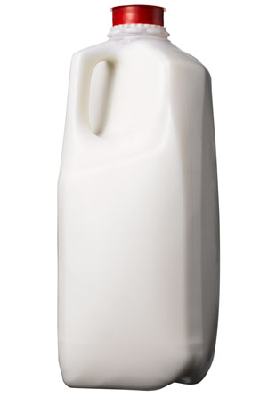

Necessities and Luxuries
When IED < 1, the good is called income inelastic or a necessity
  Examples include food, fuel, clothing, utilities, and medical services.
When IED > 1, the good is called income elastic or a luxury
  Examples include sports cars, furs, and expensive foods.

Slide 28
High Income Elasticity Implies High Price Elasticity
The effect of a change in the price of a good on its quantity demanded is the sum of:
  The substitution effect, and
  The income effect
The higher the IED, the bigger the income effect. Therefore,
The higher the IED, the higher the PED.

Slide 29
Importance of Income Elasticity of Demand
Important for decision making by both business firms and industries.
The firms which are producing high income elasticity are more interested in forecasting the level of aggregate depend on the level of economic activity (i.e level of national income) .
The demand for luxuries fluctuate highly during different phases of business cycles. During boom periods demand for luxuries increase very much and decline sharply during recessionary periods.
Decide the demand forecasting activity

Slide 30
Cross Elasticity of Demand
Demand for good X affected by change in price of some other good Y
  Use cross elasticity of demand to measure size of effect
  Percent change in consumption of good X divided by the percent change in the price of good Y
Used to determine level and amount of monopoly power held by certain firms in antitrust cases
Elasticity | Goods are considered…
e_{Qa,Pb} > 0 (+) | Substitutes
e_{Qa,Pb} = 0 | Independent goods
e_{Qa,Pb} < 0 (-) | Complements

Slide 31
Elasticity: more examples
The income elasticity of demand is the percent increase in the quantity demanded of a product when there is a one percent increase in the buyers’ income
  The cross price elasticity of demand is the percent increase in the quantity demanded of a product when there is a one percent increase in the price of another product
  The price elasticity of supply is the percent increase in the quantity supplied of a product when there is a one percent increase in the price of the product
Notice that in each case the focus is on quantification

Slide 32
Determinants of Price Elasticity of Demand
PED tends to be higher…
  the larger the number of close substitutes there are for a good
  if the good is a luxury
    That is, if the good’s income elasticity of demand is high
  if spending on the good is a large portion of total spending
  the more narrowly defined the good is
  the longer the time available to buyers to adjust to a price change

Slide 33
Cross Price Elasticity of Demand

Slide 34
Cross Elasticity of Demand (CPed)
Cross price elasticity (CPed) measures the responsiveness of demand for good X following a change in the price of good Y (a related good)
CPeD = % change in qty D of product A
% change in price of product B
With cross price elasticity we make an important distinction between substitute products and complementary goods and services.

Slide 35
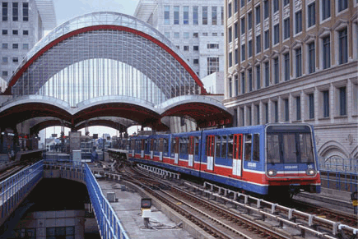




Identify some Substitutes

Slide 36






Identify some Complements

Slide 37

Cross Elasticity of Demand (CPed)
+ = Substitutes
Substitutes:
  With substitute goods such as brands of razors, an increase in the price of one good will lead to an increase in demand for the rival product
  Weak substitutes – inelastic CPed
  Close substitutes – elastic CPed
Cross price elasticity will be positive
+

Slide 38

Cross Elasticity of Demand (CPed)
- = Complements
Complements:
  Goods that are in complementary demand
  Weak complements – inelastic CPed
  Close complements –
  elastic CPed
  The cross price elasticity of demand for two complements is negative

Slide 39
Calculate the CPeD and state whether the goods are complements or substitutes?
A 10% rise in the price of fish may cause demand for chicken to increase by 2%.
The fall in the price of paper by 20% causes the demand for pens to increase by 5%.
A 20% rise in the price of ice cream causes demand for sweets to increase by 4%.
A 12% fall in the price of air fares leads to a 30% rise in the demand for foreign holidays.
A 10% rise in bikes will leave the demand for cheese unaffected.

Slide 40
Importance of Cross Price Elasticity
Importance of CPed for businesses
- Managerial decision making for formulating proper price strategy in a multi product firms
- To define the boundaries of an industry and in measuring interrelationship between industries.
Importance of Cped for Government
- Deciding cases relating to Antitrust laws and monopolistic practices used by firms

Slide 41
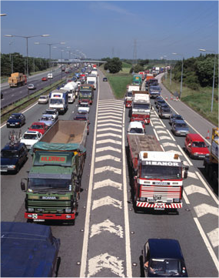
Applications of Cross Elasticity
Effect on demand for different modes of mass transport following introduction of road pricing schemes in urban areas
Rise in the price of natural gas – effect on the demand for coal used in power generation

Slide 42
Thank You

